Slide 1




“Look ma, no hands”
Jenkins Configuration-as-Code

Slide 2


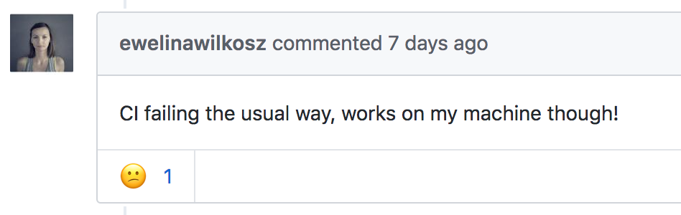



Who are we?
Name: Ewelina Wilkosz
Work: IT Consultant @ Praqma
Previous experience: Software Developer
@ Ericsson (6 years) in Krakow
Tools I work with: Jenkins (as Code), Git, Docker
@ewelinawilkosz
@ewelinawilkosz
ewe@praqma.com

Slide 3



Who are we?
Name: Nicolas De Loof
Work: Hacker @ CloudBees
Jenkins contributor & Docker Captain
Conference organizer and Video maker
@ndeloof
@ndeloof
ndeloof@cloudbees.com

Slide 4
2018 is “ * as code”

Slide 5




Infrastructure as Code
Environment as Code
Architecture as Code
CI/CD as Code

Slide 6




Manage Jenkins as Code
Jenkins infrastructure
Jenkins job configuration
Jenkins system configuration

Slide 7

Jenkins infrastructure

Slide 8
Jenkins infrastructure
Using external tools
Jenkins CLI
REST API
Python-jenkins
Jenkins-client (Java, golang)
...

Slide 9
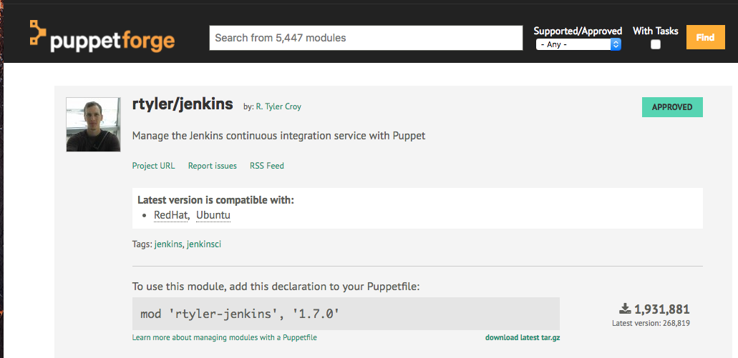
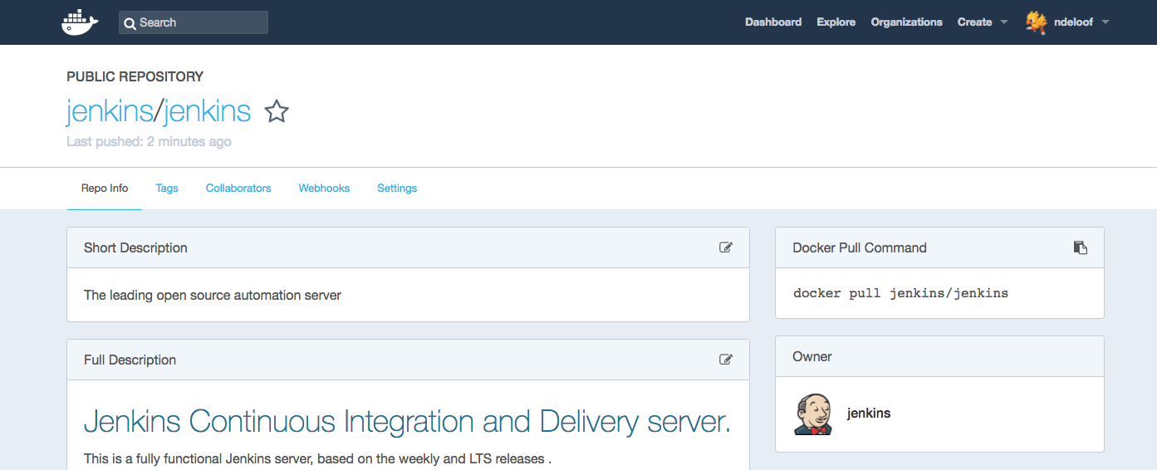
Jenkins infrastructure
Ansible, Chef, Puppet
Docker

Slide 10

jobs configuration

Slide 11
Jenkins job configuration
JobDSL plugin (groovy)
Job builder plugin (yaml)
...
Jenkins Pipeline
Multibranch
Organizations folders

Slide 12
JobDSL
job('gr8 example') { scm { github 'sheehan/job-dsl-gradle-example' } triggers { scm 'H/5 * * * *' } steps { gradle 'clean test' } publishers { archiveJunit 'build/test-results/**/*.xml' extendedEmail 'mr.sheehan@gmail.com' } }

Slide 13
Jenkins master configuration

Slide 14
“Jenkins can be installed through native system packages, Docker, or run standalone by any machine with a Java Runtime Environment (JRE) installed…”
--- an enthusiast Jenkins user

Slide 15
“… but it has to be configured manually” --- a not so enthusiast Jenkins user

Slide 16
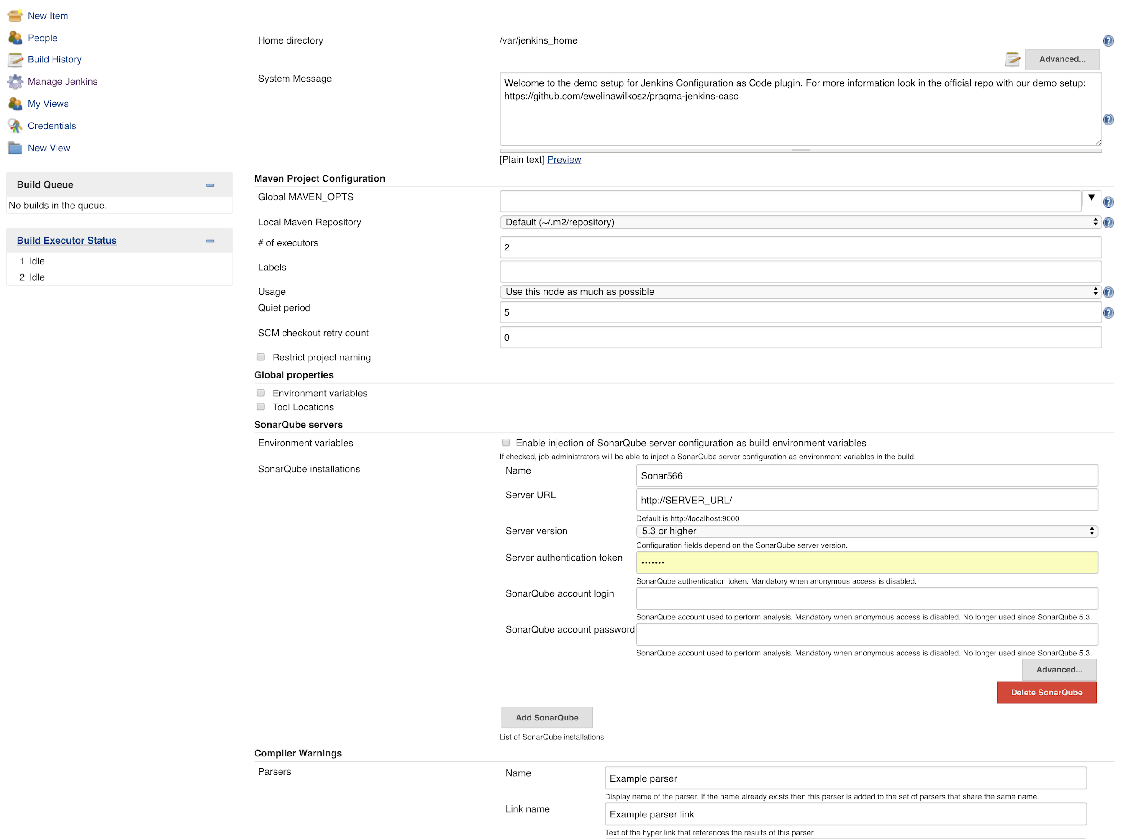
looong scroll down

Slide 17

And we don’t (always) like that

Slide 19
So how do we solve it?

Slide 20
Jenkins system configuration
init.groovy
scriptler
scm-sync-configuration 😱

Slide 21
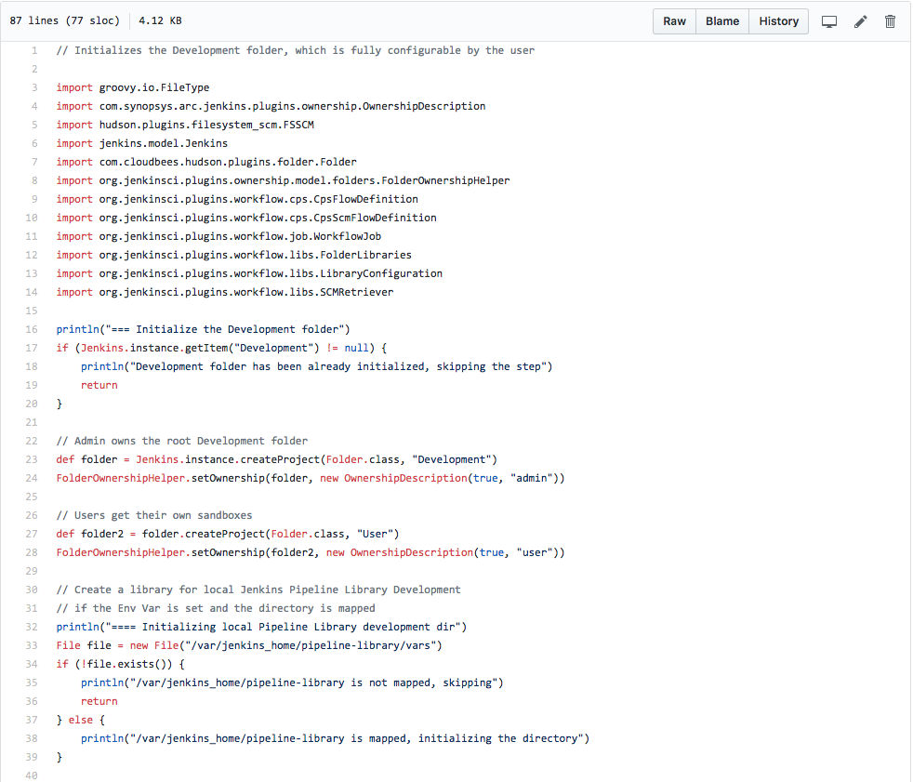
Notes:
Advanced Jenkins users rely on init.groovy boot scripts to replace the configuration UI with some scripted setup. This is powerful, but require knowledge of both groovy and Jenkins internals. Also, as a dynamic language this is subject to errors and can only be validated by running a test installation.

Slide 22

We’re not alone
Notes:
Discussing about this topic, we noticed many of us have the same issue, and are investigating for a solution

Slide 23
JENKINS-31094 (system-config-dsl)
XML templating (seen at JenkinsWorld 2017)
Various Groovy bindings
Praqma’s “JenkinsAsCodeReference”
CloudBees CTO Office’s prototype
Notes:
This is not really new. JENKINS-31094 was started in 2015
Praqma published a solution inspired by jobDSL plugin (with dedicated bindings for supported plugins)
CloudBees investigated a generic solution

Slide 24



& & to join forces
Both had working prototypes last summer
Praqma focusing on:
real world usage by customers
CloudBees focusing on:
community adoption
out-of-the box support for our products
⇒ https://github.com/jenkinsci/configuration-as-code-plugin
Notes:
1 + 1 > 2

Slide 25
Let’s make it as easy as possible

Slide 26
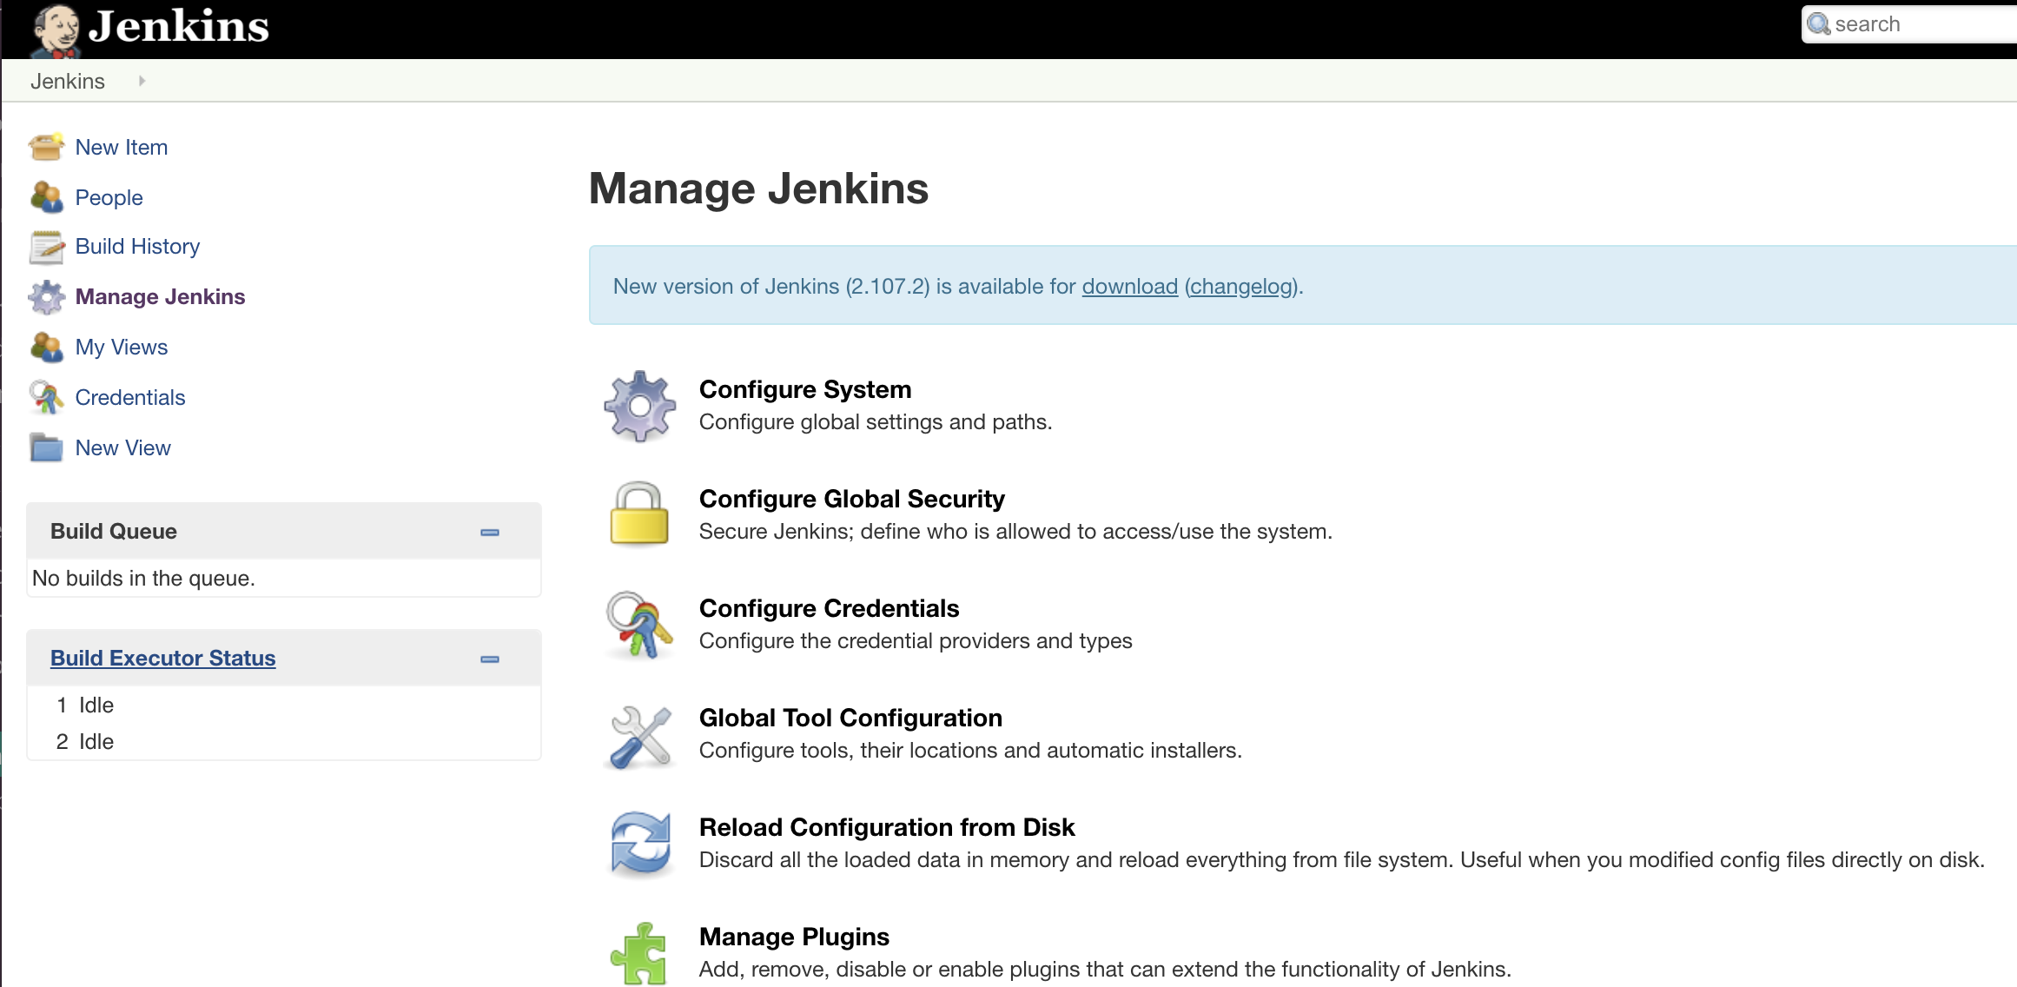

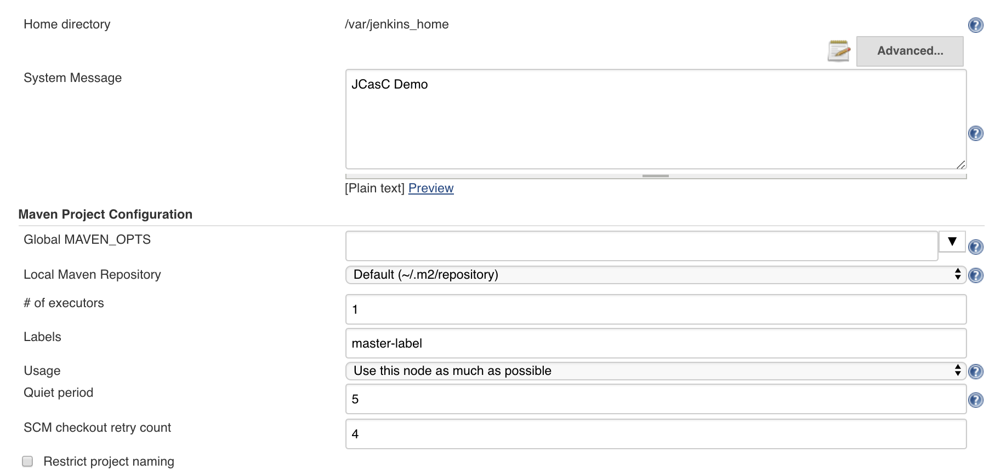
jenkins.yaml
jenkins: systemMessage: "JCasC Demo"
numExecutors: 1
scmCheckoutRetryCount: 4
mode: NORMAL
securityRealm:
local:
allowsSignup: false
users:
- id: demoAdmin
password: ${adminpw}

Slide 27
Main benefits
Safety
Traceability
Speed
Easy to use
Easy to reuse

Slide 28
There are challenges
Manage configuration as human-readable config file(s)
Self-describing model to reflect Web UI
Configure all jenkins initial setup (including plugins)
Support most (*) plugins without extra development effort
Generate documentation and validation tools (schema)
Notes:
We want configuration to be human readable and easy to understand by non-jenkins experts
We want to support everything on jenkins that will require some automated setup
We want to support most (if not all) plugins out-of-the-box
We want to automatically generate up-to-date documentation as well as tooling

Slide 29

human-readable config file(s)
Structured content
Nothing language centric
No groovy / ruby / xx
Readable and commentable
Notes:
We selected YAML, as :
Human readable
Language agnostic
Support for comments (which will help distribute samples)
Used by a large majority of DevOps tools

Slide 30


YAML ...
Indentation matters
photo credit : Justin Palmer @Caged

Slide 31

Web UI as implicit documentation
Config element in web UI
==
Config element in YAML
“ No need to be a Jenkins expert to do it right” -- Obi Wan Kenobi

Slide 32
Configure Jenkins in yaml
Obvious, isn’t it ?
jenkins:
securityRealm:
ldap:
configurations:
- server: ldap.acme.com
rootDN: dc=acme,dc=fr
managerPasswordSecret: ${LDAP_PASSWORD}
cache:
size: 100
ttl: 10
userIdStrategy: CaseSensitive
groupIdStrategy: CaseSensitive
tool:
git:
installations:
- name: git
- path: /bin/git
Notes:
Here is a typical configuration file. Concise and obvious what it’s doing, isn’t it ?
Compare to equivalent groovy script or XML template :P
NB: we support secret injection (${LDAP_PASSWORD}) from environment variables, docker secret, Vault (more to come)
_BUT_ no templating. If you want to script this file, have your favourite template engine (Chef|Puppet|Ansible|Salt|Perl...) produce this yaml content

Slide 33

Configure ALL jenkins initial setup
No hand on keyboard
No click on web UI
to deploy
a fully working Jenkins master
Notes:
We want to support a full setup for a jenkins master, ready to start building stuff without a single manual step
== even more than the “setup wizard” in jenkins 2.x

Slide 34

Support ALL plugins
No need to write glue code for every supported plugin
Most(*) plugins supported out of the box
Others can bundle adapter code
(*) could require some minor changes
!! we require configuration-as-code-support plugin to be installed, for now !!
Notes:
Plugin support should not require “glue” adapter code. Based on some conventions, we should be able to support most of them
AND have some mechanisms to support the one with some weird implementation

Slide 35

Generate documentation and validation tools
Can validate without running a test master
IDE support
Notes:
Up-to-date documentation is generated automatically, as tooling to validate configuration file or assist in writing it (with adequate IDE support)

Slide 36
Here comes JCasC

Slide 37
Where to find it?!
https://github.com/jenkinsci/configuration-as-code-plugin
Implementation details and guide for plugin developers available in plugin’s github repository

Slide 38


DEMO

Slide 39
How it works

Slide 40
Live Jenkins instance
Data model
Core + plugins
Yaml parser
Doc generator
Schema validator
Notes:
From a Jenkins core version + plugins, we produce a configuration data model.
This model drives yaml parser, and is used to produce documentation and json schema (possibly more)
Ensure everything is aligned.

Slide 41
Introspection
Jenkins-core 2.xx + plugins [ git:3.7.0, ...]
Jenkins root instance
Descriptors (global configuration)
+ Special component with CasC support
=> hierarchical data model, trying to mimic Jenkins UI
Notes:
We use java introspection (reflection) to discover data model
Special API for those with dedicated glue code

Slide 42
Requirements
Target components need to follow some basic design rules
We rely on UI data binding mechanism (@DataBound)
Component to directly parse StaplerRequest / JsonObject can’t be introspected
Recommendations to plugin developers github.com/jenkinsci/configuration-as-code-plugin/blob/master/PLUGINS.md
Pull requests on major plugins we want to support github.com/jenkinsci/mailer-plugin/pull/39
Notes:
We rely on UI DataBinding
UI is the “natural” model end-user knows well and expect in configuration file
This ensure we are up-to-date with changes in code, without need to upgrade plugin or some adapter component

Slide 43
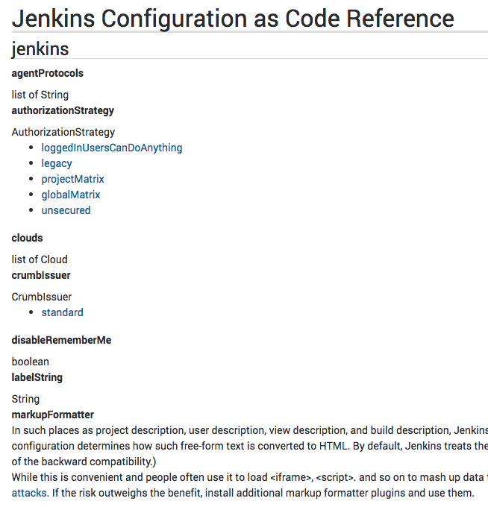
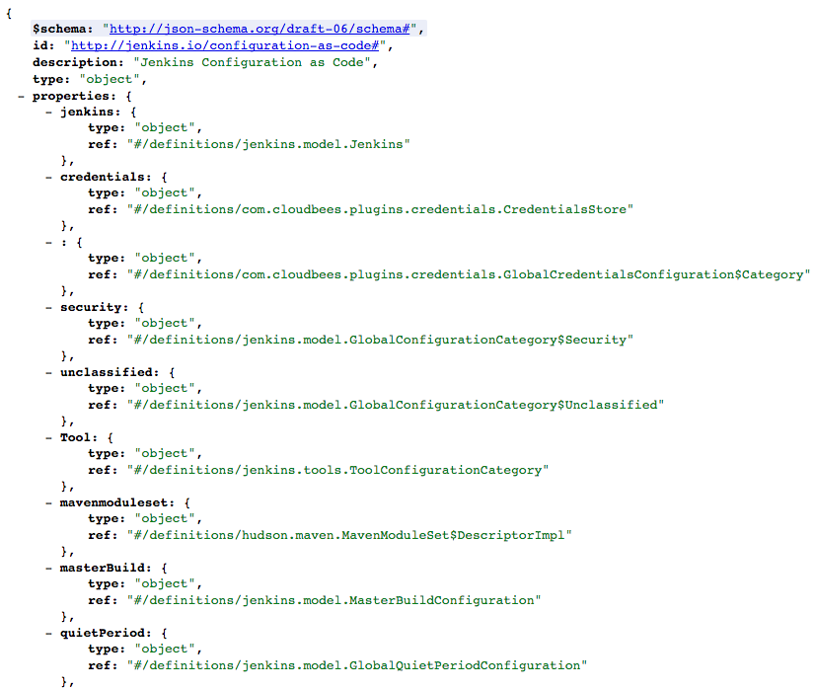
Doc/Schema Generation
JENKISN/plugin/configuration-as-code/
JENKINS/plugin/configuration-as-code/schema
Notes:
Sample generated doc and schema
Doc includes description and help tips from the web UI, for better user experience

Slide 44
Corner cases
Some components hardly fit this model
For those we can develop dedicated Configurator adapter classes.
Notes:
Sometime, for legacy reason or complex internal design, component hardly match this model
For those we have a simple API to implement to add dedicated adapter code

Slide 45

Under the hood

Slide 46
Root Elements → RootElementConfigurator
jenkins:
securityRealm:
ldap:
configurations:
- server: ldap.acme.com
rootDN: dc=acme,dc=fr
managerPasswordSecret: ${LDAP_PASSWORD}
cache:
size: 100
ttl: 10
userIdStrategy: CaseSensitive
groupIdStrategy: CaseSensitive
tool:
git:
installations:
- name: git
- path: /bin/git
Notes:
Yaml file defines few root elements. For those we search a matching “RootConfigurator”. Typically, jenkins -> JenkinsConfigurator.
Starting here we have a java type as target object to configure

Slide 47
Root Element
JenkinsConfigurator “jenkins” → Jenkins.instance root object
GlobalConfigurationCategoryConfigurator “tools”, “security”, … → Descriptors grouped by categories
DescriptorRootElementConfigurator Uncategorized Descriptors with a global configuration page “mailer”, ...
CredentialsRootConfigurator “credentials” → Glue code for credentials plugin (more on this later)

Slide 48
Child element → Attribute
jenkins:
securityRealm:
ldap:
configurations:
- server: ldap.acme.com
rootDN: dc=acme,dc=fr
managerPasswordSecret: ${LDAP_PASSWORD}
cache:
size: 100
ttl: 10
userIdStrategy: CaseSensitive
groupIdStrategy: CaseSensitive
Notes:
From a target type, we discover attributes (i.e configurable properties) by reflection

Slide 49
Attribute
Configurator do describe a target component as a set of Attributes
Attribute handle :
Name
Type (inferred by reflection on generics)
Multiplicity (Collection<x>)
Setting value
Notes:
Attribute define the name of a property and what has to be constructed to set it
API is flexible. Setting value can be just about calling a setter method, or full dedicated code (useful for corne-cases : factory methods or so)

Slide 50
Generic Attribute
writable JavaBean property | DataBound constructor parameter
public void setSecurityRealm(SecurityRealm securityRealm) {
SecurityRealm is an ExtensionPoint (abstract)
Configuration-as-Code need to identify implementation
jenkins:
securityRealm:
ldap:
Notes:
For extension points, target type is abstract. So we need to identify concrete target implementation.
We use a nested String to define the target implementation

Slide 51
Extension point implementation
SecurityRealm is an ExtensionPoints => candidates implementations:
LegacySecurityRealm → @Symbol(“legacy”) → legacy HudsonPrivateSecurityRealm → @Symbol(“local”) → local ActiveDirectorySecurityRealm → ActiveDirectory → activedirectory LDAPSecurityRealm → LDAP → ldap
jenkins:
securityRealm:
ldap:
Notes:
Based on Extension Point we have a limited list of candidates. We give them a name
Either based on @Symbol annotation
Or assuming some (very common) naming convention have been used
At least, we support class name if everything failed

Slide 52
Build target Component
@DataBoundConstructor public LDAPSecurityRealm( List<LDAPConfiguration> configurations, boolean disableMailAddressResolver, CacheConfiguration cache, IdStrategy userIdStrategy, IdStrategy groupIdStrategy)
+ DataBoundSetters
jenkins:
securityRealm:
ldap:
configurations:
...
cache:
size: 100
ttl: 10
userIdStrategy: CaseSensitive
groupIdStrategy: CaseSensitive
Notes:
We can build any Describable component using @DataBoud constructor and setters

Slide 53
Corner cases
Setter method defined for internal needs / backward compatibility We exclude @Deprecated and @Restricted
[WiP] Technical facing Property name : “labelString” We support @Symbol on setters
Not a Describable / Internal model is … weird for end-user Custom Configurator | Attribute implementation
Notes:
Many component do expose setter methods for legacy reasons or internal use
We check for @Deprecated and @Restricted so they are _not_ exposed to configuration-as-code, and avoid confusion
Sometime internal attribute name don’t match the user-facing form field name. Support for @Symbol on those setter methods allow to fix this
Custom Configurator or Attribute allows to support various corner cases.

Slide 54
Custom Configurator, a.k.a “Glue Code”
Sample : expose a user-friendly credentials model
CredentialsRootConfigurator custom code
credentials:
system:
domainCredentials:
# global credentials
- credentials:
- certificate:
scope: SYSTEM
id: ssh_private_key
password: ${SSH_KEY_PASSWORD}
keyStoreSource:
fileOnMaster:
keyStoreFile: /docker/secret/id_rsa
A fake Attribute "system" to expose DomainCredentials (List)
with custom setter implementation:
target.setDomainCredentialsMap(
DomainCredentials.asMap(value)
)
Notes:
Sample : Glue code for credentials plugin
Credentials in web UI seems to be hierarchical (credentials > system > global > xxx)
Internally this is a way more complex model
Using yaml Map support, we can offer with a dozen line of code support for setting some initial credentials.
Could be improved later, but we expect configuration-as-code users to prefer a CredentialsProvider plugin implementation to connect to a secret store (like Vault or CyberArk)

Slide 55
Status

Slide 56



1.0 is there !
… even 1.3 (released last week)
We welcome Feedback !
jenkins-users mailing list
jenkinsci/configuration-as-code gitter
github issues
Notes:
We prepared a demo building a docker container, which is ready to start and build Jenkinsfile from a github repository
NOTE: we support initial seed job relying on jobDSL plugin.

Slide 57
Features
Read configuration from local drive or url, REST API or CLI
Reload configuration (Manage Jenkins → Configuration as Code → Reload)
Export existing jenkins instance configuration into yaml (here be dragons)
Compatibility dashboard : https://issues.jenkins-ci.org/secure/Dashboard.jspa?selectPageId=17346 Please report issues with “jcasc-compatibility” label
Additionally docker demo setup (which can be easily adapted for different than demo purpose): https://github.com/Praqma/praqma-jenkins-casc

Slide 58

JEP-201
Make this THE configuration component for Jenkins community
https://github.com/jenkinsci/jep/blob/master/jep/201/README.adoc
Notes:
To drag attention to this project, we wrote an (informative) Jenkins Enhancement Proposal, so community knows about this and out intent

Slide 59
Give it a try
Report missing plugin support / broken features
Contribute test cases (easy) or fixes (not so easy :P)

Slide 60
How to talk to us?
github issues working well for reporting problems
we’re monitoring Jenkins Users, Jenkins Developers mailing lists
but...
gitter channel is a place to go to: https://gitter.im/jenkinsci/configuration-as-code-plugin

Slide 61

Questions?

Slide 62
Thank you!

